Slide 1

MINOR PROJECT PRESENTATION ON Farmer-connect
SCHOOL OF ENGINEERING AND TECHNOLOGY
DEPARTMENT OF COMPUTER SCIENCE AND ENGINEERING
Presented By:
Pritiprasanna Nayak(22UG0I0317)
Anshuman Behera(22UG0101321)
Akash Nag(22UG010353)
Under the Guidance of Mr. Sitanshu Kar
Dr. (Mrs.) Gitanjali Mishra
Assistant Professor
Dept. Of CSE,
GIET University , Gunupur

Slide 2
OUTLINES
S.NO. | CONTENTS | PAGE NO.
1 | PROBLEM STATEMENT | 3
2 | INTRODUCTION | 4
3 | TECHNOLOGIES USED | 5-6
4 | NECESSARY DIAGRAMS | 7-10
5 | FEATURES | 11
6 | CHALLENGES | 12
7 | LIMITATIONS | 13
8 | SCREENSHOTS | 14
9 | CONCLUSION | 15
10 | FUTURE ENHANCEMENT | 16
11 | REFERENCES | 17

Slide 3
Problem Statement
Mobile App For Direct Market Access For Farmers(SIH-1620).
Farmers often face challenges in accessing markets, leading to lower income due to middlemen. This gap restricts their ability to sell produce at fair prices.

Slide 4
INTRODUCTION
The Farmer Connect is a flutter based mobile application that provides access to farmers to interact directly with the consumers.
This app reduces the need of middlemen, which will increase the profits on produce.
Farmers can add and manage their product , creating an efficient and centralized environment.

Slide 5
Technologies used
Visual Studio Code - Visual Studio Code, also commonly referred to as VS Code, is a source-code editor developed by Microsoft for Windows, Linux and macOS. Features include support for debugging, syntax highlighting, intelligent code completion, snippets, code refactoring, and embedded Git.
Flutter - Flutter is an open-source UI software development kit created by Google. It is used to develop cross platform applications from a single codebase for any web browser, Fuchsia, Android, iOS, Linux, macOS, and Windows. First described in 2015, Flutter was released in May 2017.
Firebase - Firebase, Inc. is a set of backend cloud computing services and application development platforms provided by Google. It hosts databases, services, authentication, and integration for a variety of applications, including Android, iOS, JavaScript, Node.js, Java, Unity, PHP, and C++.
Dart Programming Language - Dart is a client-optimized, object-oriented programming language developed by Google, primarily used for building cross-platform applications, especially with the Flutter framework, and known for its fast development cycles and efficient execution.

Slide 6


Technologies used
Hardware Requirement
1.Laptop
Processor - AMD Ryzen 5 4600H
RAM - 4GB
Memory – 100GB
Dedicated GPU
2. Android Phone
Software Requirement
OS - Windows 11
IDE - Visual Studio Code
Frontend – Flutter Framework
Backend – Dart
Database – Firebase Realtime Database

Slide 7
Necessary Diagrams

Slide 8
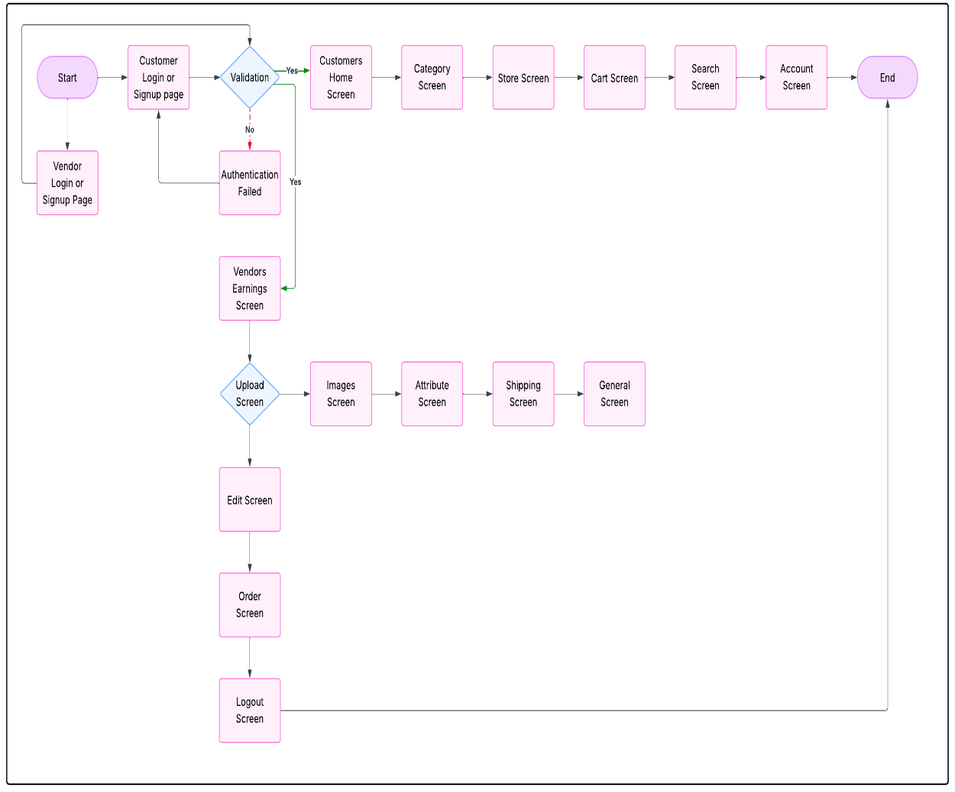
Flow chart

Slide 9
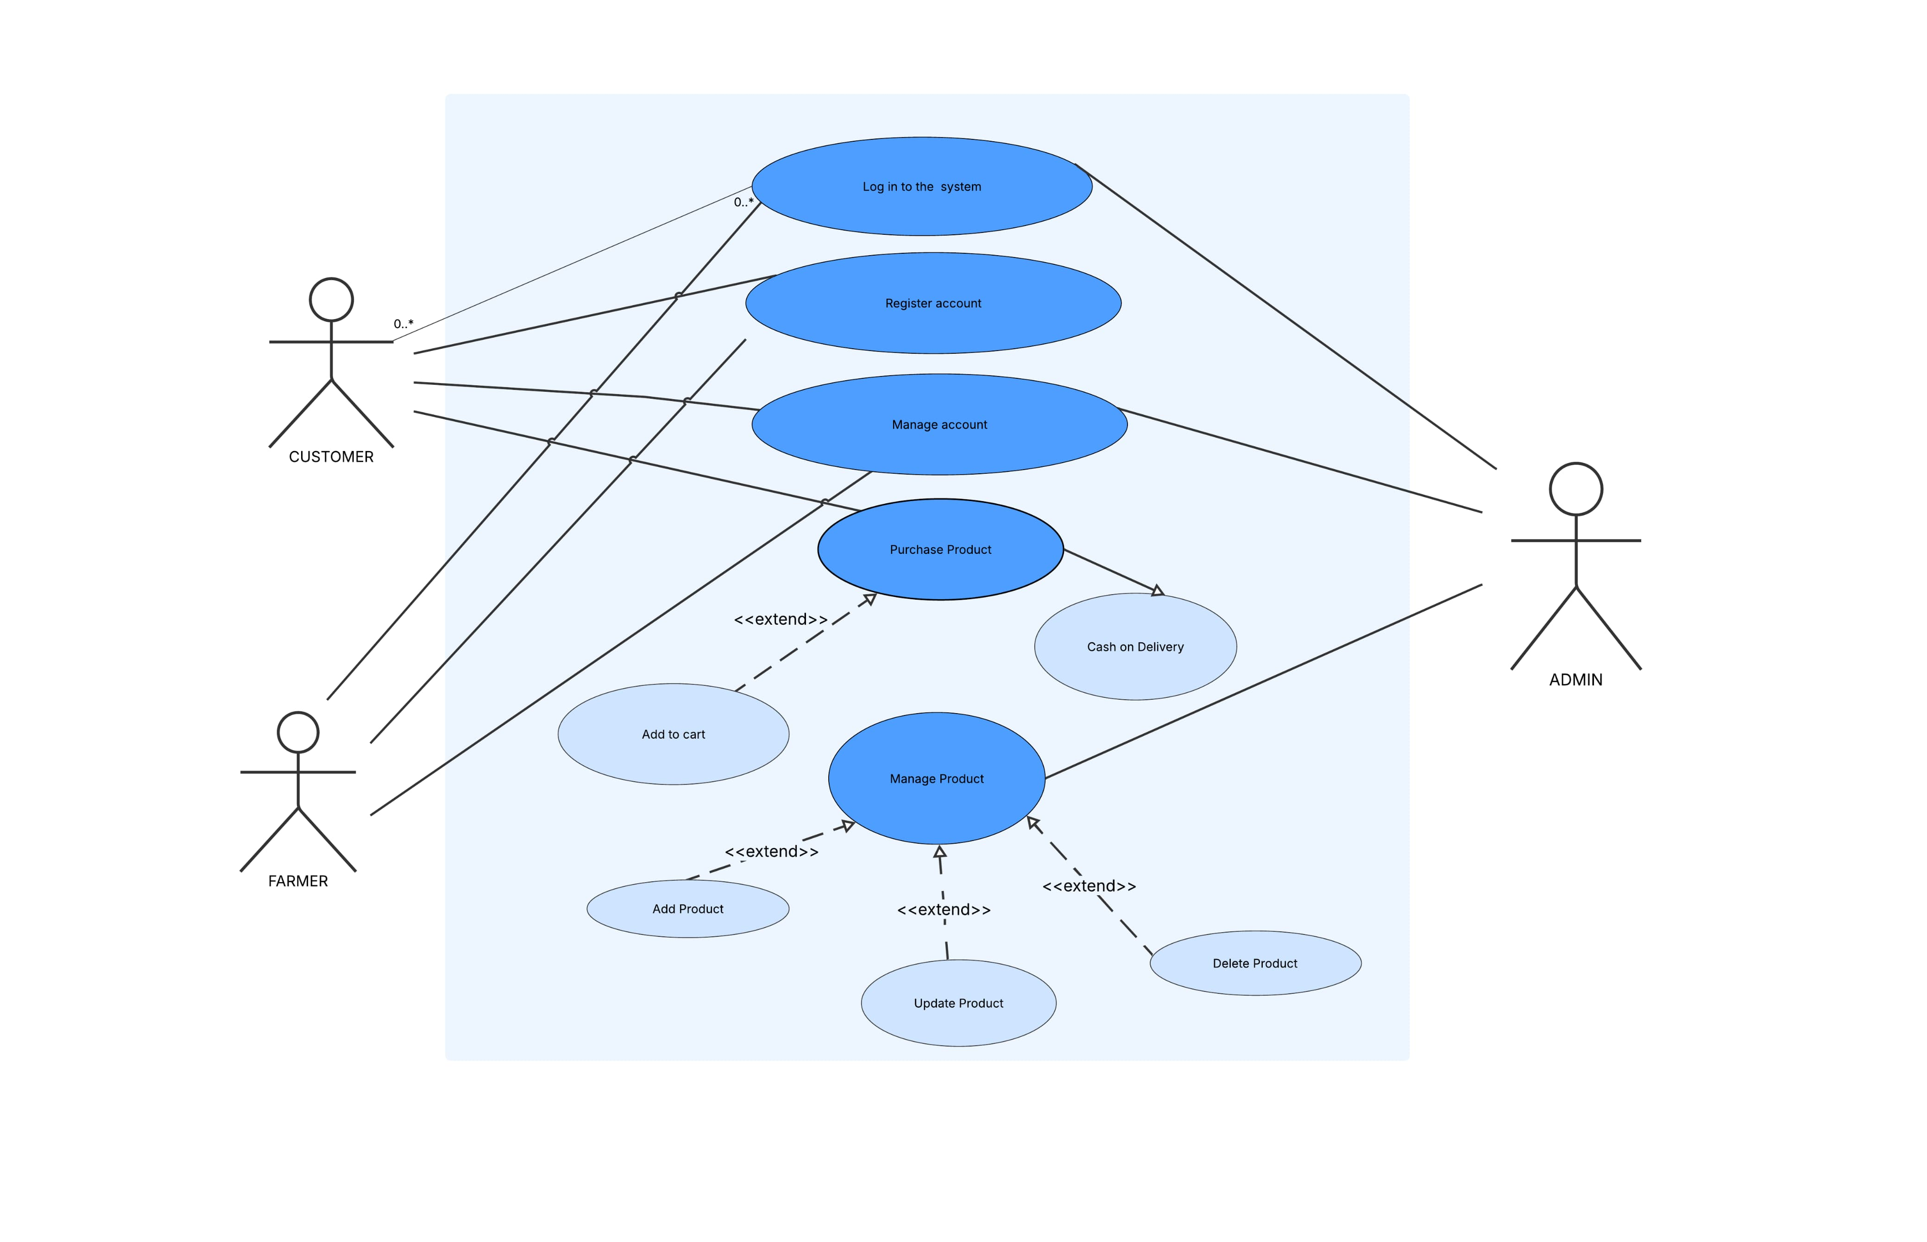
Use case diagram

Slide 10
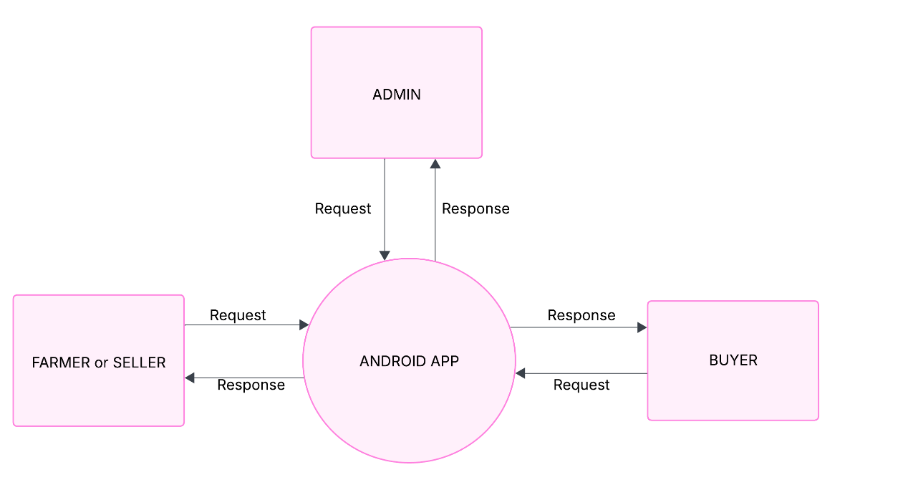
DATA FLOW DIAGRAM
LEVEL O DFD (CONTEXT DIAGRAM)

Slide 11
FEATURES
User Authentication Separate login/signup for farmers and users.
Supported in both Android and IOS
User friendly interface
Single app for both farmer and consumers.
Real time Content update
Admin Dashboard
Admin grants and revokes all the permissions.

Slide 12
CHALLENGES
Designing Scalable Content Structure Creating a flexible content model to support nested .
Implementing Role-Based Access Control Ensuring proper access restrictions between farmer and consumer.
Real-Time Content Updates Syncing content efficiently between backend and frontend.
UI/UX Consistency Building a responsive and intuitive interface for both farmer and consumer.

Slide 13
LIMITATIONS
Limited Internet Connectivity in rural areas
Many farmers in remote locations may not have stable internet access, which could hinder the adoption and real-time functionality of the platform.
Digital Literacy
Not all farmers are tech-savvy. The success of the platform depends on adequate training and support for users unfamiliar with smartphones or digital interfaces.
Dependency on Mobile
The system assumes access to smartphones, which might not be affordable or readily available to all farmers.

Slide 14
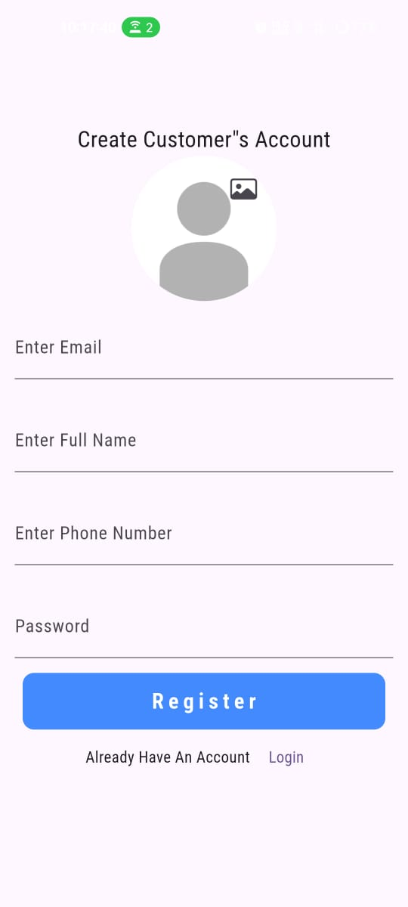
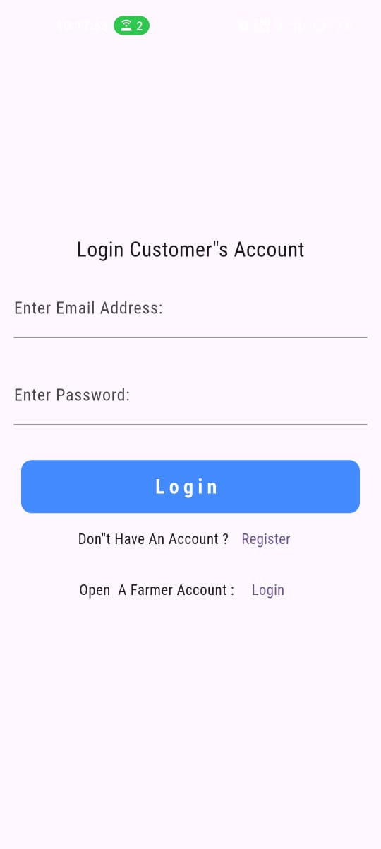
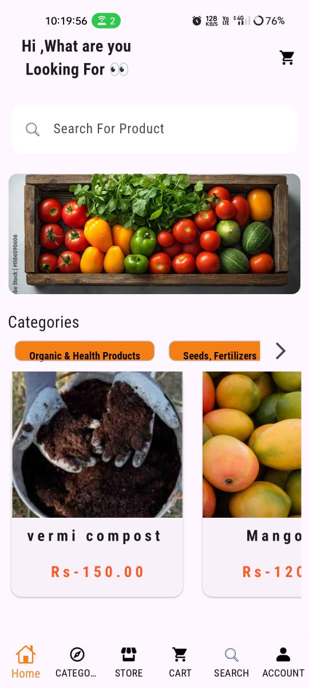
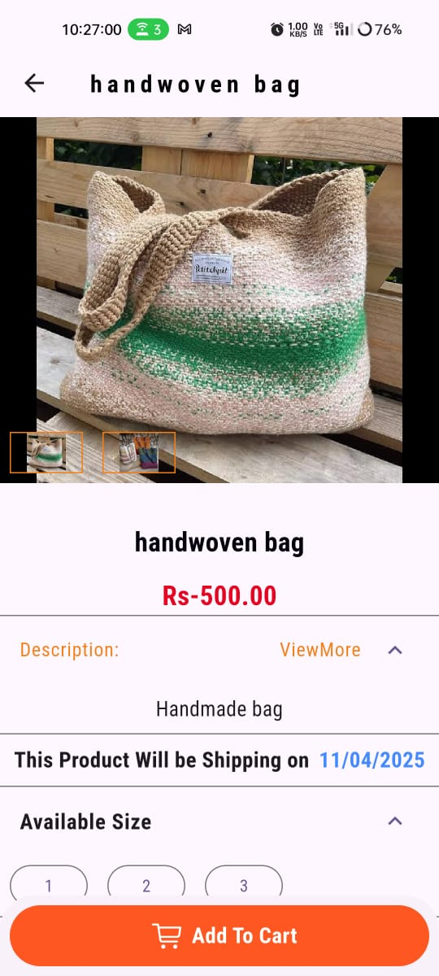
SCREENSHOTS

Slide 15
CONCLUSION
Direct market access is crucial for farmers, significantly improving their income by eliminating intermediaries. The proposed mobile app facilitates this connection, empowering farmers to sell directly to consumers and retailers.
The Farmer Connect system represents a transformative step toward modernizing agriculture by bridging the gap between farmers, markets, and technology. With the right support, training, and continued innovation, Farmer Connect can become a powerful tool for sustainable agricultural development and rural empowerment.

Slide 16
FUTURE ENHANCEMENT
AI-Powered Crop Advisory
Integrate machine learning models to provide personalized, predictive crop and pest management recommendations based on real-time weather, soil, and crop data.
Multilingual Voice Assistant
Add a voice-enabled assistant that supports regional languages to assist illiterate or semi-literate farmers with navigation and task completion.
Digital Payment Integration
Include support for mobile wallets and UPI for seamless payments, subsidies, and transaction tracking within the app.

Slide 17
REFERENCE
Flutter Fire Documentation
https://firebase.flutter.dev/docs/overview/
Firebase Documentation
https://firebase.google.com/docs/

Slide 18
Q&A
Thank you all for your attention! Any questions?

